Slide 1
Chapter 4: More Object Concepts

Slide 2
Objectives
Understand blocks and scope
Overload a method
Avoid ambiguity
Create and call constructors with parameters
Use the this reference
Java Programming, Eighth Edition

Slide 3
Objectives (cont’d.)
Use static fields
Use automatically imported, prewritten constants and methods
Use composition and nest classes
Java Programming, Eighth Edition

Slide 4
Understanding Blocks and Scope
Blocks
  Use opening and closing curly braces
  Can exist entirely within another block or entirely outside of and separate from another block
  Cannot overlap
  Types:
    Outside block (or outer block)
    Inside block (or inner block)
    Nested (contained entirely within the outside block)
Java Programming, Eighth Edition

Slide 5
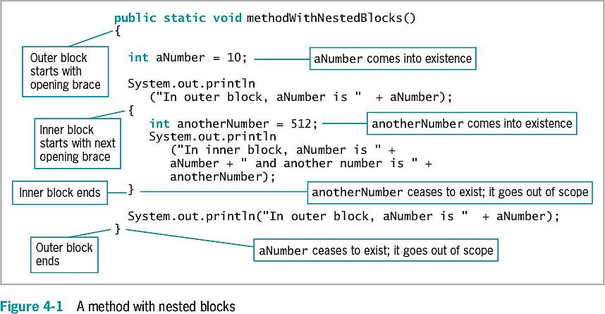
Understanding Blocks and Scope (cont’d.)
Java Programming, Eighth Edition

Slide 6
Understanding Blocks and Scope (cont’d.)
Scope
  The portion of a program within which you can refer to a variable
  Comes into scope
    Variable comes into existence
  Goes out of scope
    Variable ceases to exist
Java Programming, Eighth Edition

Slide 7
Understanding Blocks and Scope (cont’d.)
Redeclare the variable
  You cannot declare the same variable name more than once within a block
  An illegal action
Java Programming, Eighth Edition

Slide 8
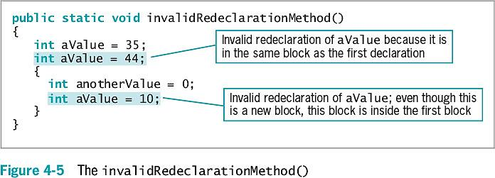
Understanding Blocks and Scope (cont’d.)
Java Programming, Eighth Edition

Slide 9
Understanding Blocks and Scope (cont’d.)
Override
  Occurs when you use the variable’s name within the method in which it is declared
    The variable takes precedence over any other variable with the same name in another method
  Shadowing: locally declared variables always mask or hide other variables with the same name elsewhere in the class
Java Programming, Eighth Edition

Slide 10
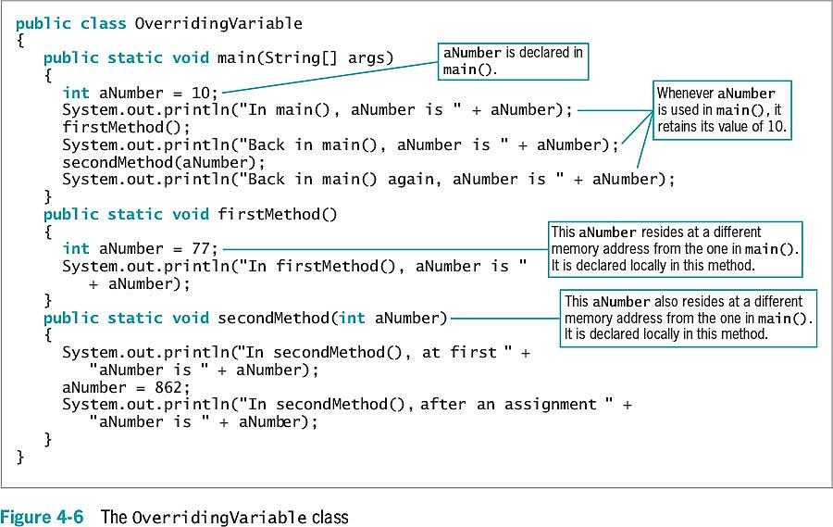
Understanding Blocks and Scope (cont’d.)
Java Programming, Eighth Edition

Slide 11
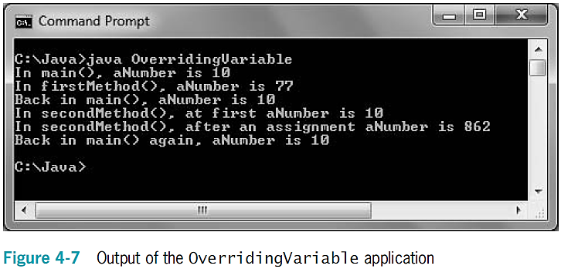
Understanding Blocks and Scope (cont’d.)
Java Programming, Eighth Edition

Slide 12
Overloading a Method
Overloading
  Using one term to indicate diverse meanings
  Writing multiple methods with the same name but with different arguments
  The compiler understands the meaning based on the arguments used with the method call
  It is convenient for programmers to use one reasonable name
    For tasks that are functionally identical
    Except for argument types
Java Programming, Eighth Edition

Slide 13
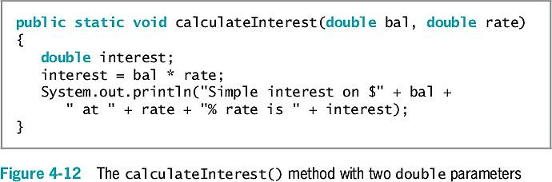
Overloading a Method (cont’d.)
Java Programming, Eighth Edition

Slide 14
Automatic Type Promotion in Method Calls
If an application contains just one version of a method:
  Call the method using a parameter of the correct data type or one that can be promoted to the correct data type
    Order of promotion:
      double, float, long, int
Java Programming, Eighth Edition

Slide 15
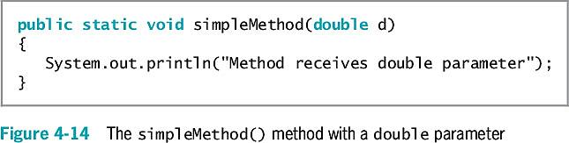
Automatic Type Promotion in Method Calls (cont’d.)
Java Programming, Eighth Edition

Slide 16
Learning About Ambiguity
Ambiguous situation
  When the compiler cannot determine which method to use
Overload methods
  Correctly provide different parameter lists for methods with the same name
Illegal methods
  Methods with identical names that have identical argument lists but different return types
Java Programming, Eighth Edition

Slide 17
Creating and Calling Constructors with Parameters
Java automatically provides a constructor method when class-created default constructors do not require parameters
Writing your own constructor method:
  Ensures that fields within classes are initialized to appropriate default values
  Constructors can receive parameters
    Used for initialization purposes
Java Programming, Eighth Edition

Slide 18
Creating and Calling Constructors with Parameters (cont’d.)
When you write a constructor for a class, you no longer receive the automatically provided default constructor
If a class’s only constructor requires an argument, you must provide an argument for every object of the class
Java Programming, Eighth Edition

Slide 19
Overloading Constructors
Use constructor parameters to initialize field values, or any other purpose
If constructor parameter lists differ, there is no ambiguity about which constructor method to call
Java Programming, Eighth Edition

Slide 20
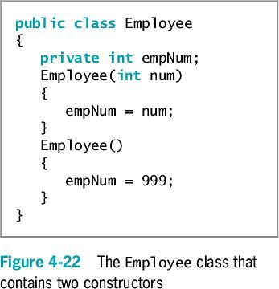
Overloading Constructors (cont’d.)
Java Programming, Eighth Edition

Slide 21
Learning About the this Reference
Instantiating an object from a class
  Memory is reserved for each instance field in the class
  It is not necessary to store a separate copy of each variable and method for each instantiation of a class
In Java:
  One copy of each method in a class is stored
  All instantiated objects can use one copy
Java Programming, Eighth Edition

Slide 22
Learning About the this Reference (cont’d.)
Reference
  An object’s memory address
  Implicit
    Automatically understood without actually being written
Java Programming, Eighth Edition

Slide 23
Learning About the this Reference (cont’d.)
this reference
  The reference to an object
  Passed to any object’s nonstatic class method
  A reserved word in Java
You do not need to use the this reference in methods you write in most situations
Java Programming, Eighth Edition

Slide 24
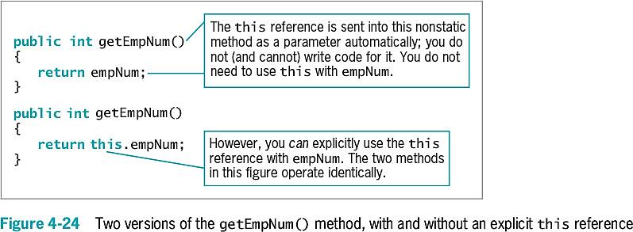
Learning About the this Reference (cont’d.)
Java Programming, Eighth Edition

Slide 25
Learning About the this Reference (cont’d.)
this reference (cont’d.)
  Implicitly received by instance methods
  Use to make classes work correctly
  When used with a field name in a class method, the reference is to the class field instead of to the local variable declared within the method
Java Programming, Eighth Edition

Slide 26
Using the this Reference to Make Overloaded Constructors More Efficient
Avoid repetition within constructors
Constructor calls other constructor
  this()
  More efficient and less error-prone
Java Programming, Eighth Edition

Slide 27
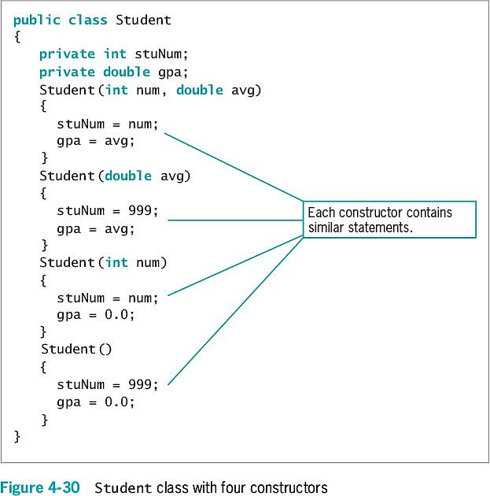
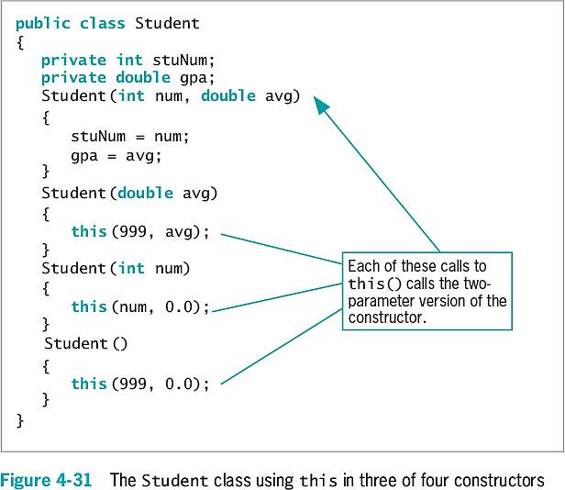
Java Programming, Eighth Edition

Slide 28
Using static Fields
Class methods
  Do not have the this reference
  Have no object associated with them
Class variables
  Shared by every instantiation of a class
  Only one copy of a static class variable per class
Java Programming, Eighth Edition

Slide 29
Using Constant Fields
Create named constants using the keyword final
  Make its value unalterable after construction
Can be set in the class constructor
  After construction, you cannot change the final field’s value
Java Programming, Eighth Edition

Slide 30
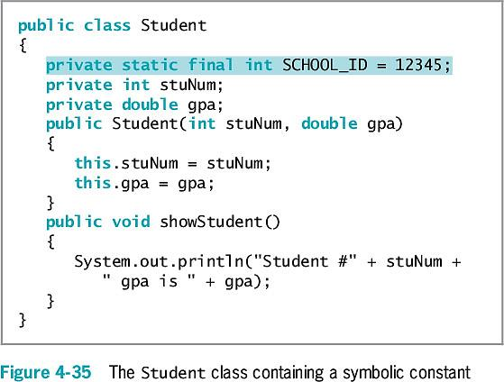
Using Constant Fields (cont’d.)
Java Programming, Eighth Edition

Slide 31
Using Automatically Imported, Prewritten Constants and Methods
Many classes are commonly used by a wide variety of programmers
Package or library of classes
  A folder that provides a convenient grouping for classes
  Many contain classes available only if they are explicitly named within a program
  Some classes are available automatically
Java Programming, Eighth Edition

Slide 32
Using Automatically Imported, Prewritten Constants and Methods (cont’d.)
java.lang package
  Implicitly imported into every Java program
  The only automatically imported, named package
  The classes it contains are fundamental classes (or basic classes)
Optional classes
  Must be explicitly named
Java Programming, Eighth Edition

Slide 33
Using Automatically Imported, Prewritten Constants and Methods (cont’d.)
java.lang.Math class
  Contains constants and methods used to perform common mathematical functions
  No need to create an instance
  Imported automatically
  Cannot instantiate objects of type Math
    The constructor for the Math class is private
Java Programming, Eighth Edition

Slide 34
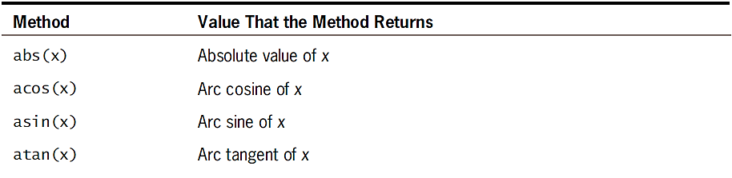
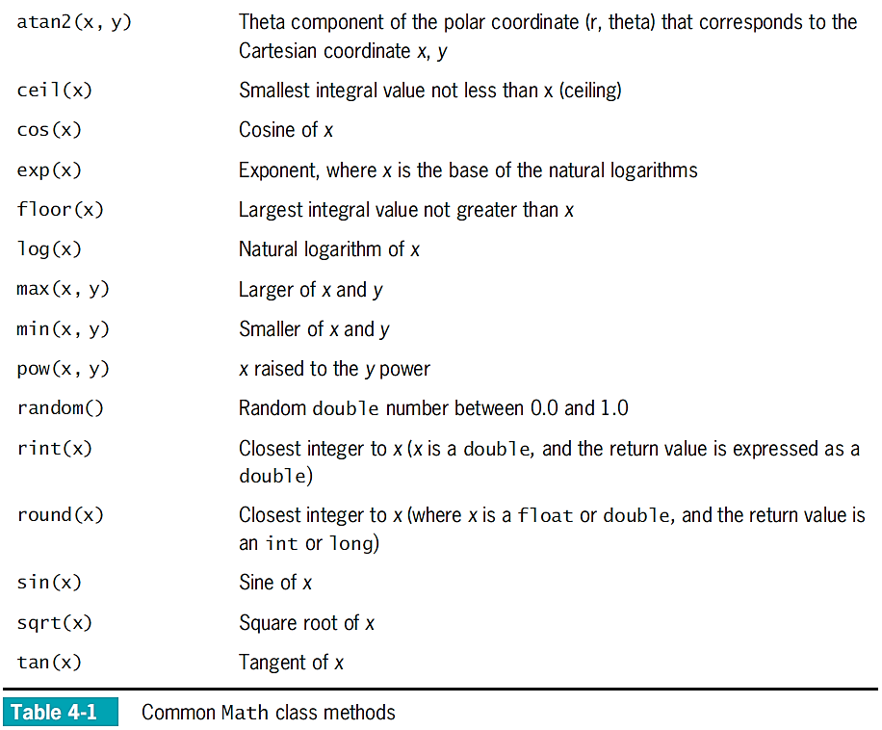
Java Programming, Eighth Edition

Slide 35
Importing Classes That Are Not Imported Automatically
Use prewritten classes
  Use the entire path with the class name
  Import the class
  Import the package that contains the class
Java Programming, Eighth Edition

Slide 36
Importing Classes That Are Not Imported Automatically (cont’d.)
Wildcard symbol
  An alternative to importing the class
    Import the entire package of classes
  Asterisk wildcard
    Can be replaced by any set of characters
    Represents all classes in a package
    There is no disadvantage to importing extra classes
  Importing each class by name can be a form of documentation
Java Programming, Eighth Edition

Slide 37
Using the LocalDate Class
LocalDate class
  No time zone information included with this class (local date only)
  Static methods now() and of()
  Class constructors are non-public
  Various methods provided to perform date arithmetic
Enumeration
  Data type that consists of a list of values, such as:
    JANUARY, FEBRUARY, MARCH etc.
Java Programming, Eighth Edition

Slide 38
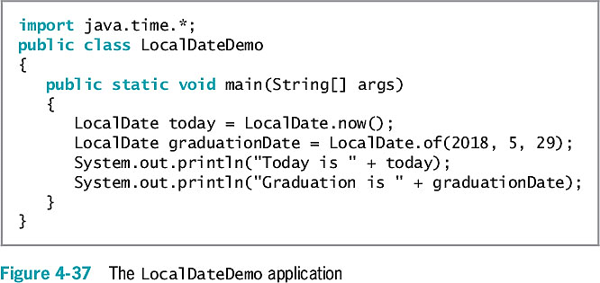
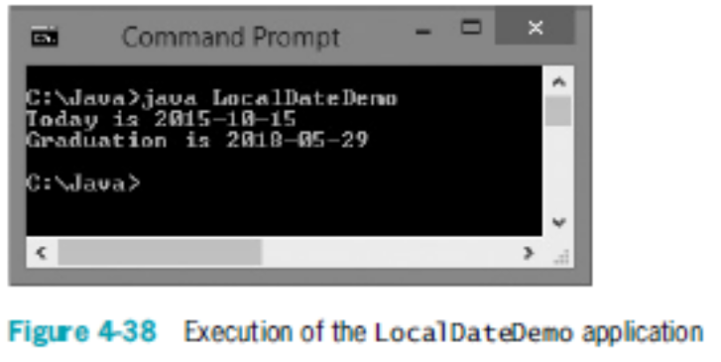
Using the LocalDate Class (cont’d.)
Java Programming, Eighth Edition

Slide 39
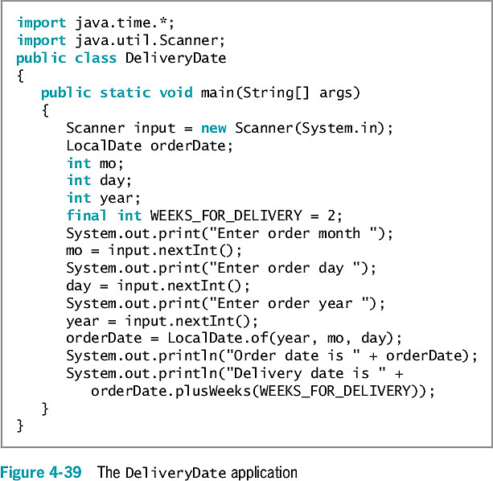
Using the LocalDate Class (cont’d.)
Java Programming, Eighth Edition

Slide 40
Understanding Composition and Nested Classes
Composition
  Describes the relationship between classes when an object of one class data field is within another class
  Called a has-a relationship
    Because one class “has an” instance of another
Remember to supply values for a contained object if it has no default constructor
Java Programming, Eighth Edition

Slide 41
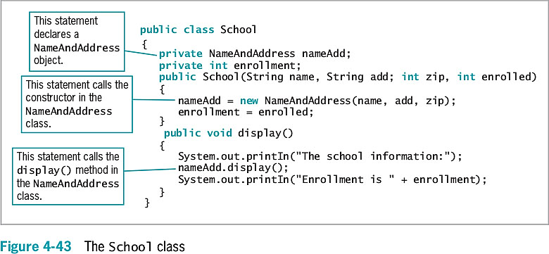
Understanding Composition and Nested Classes (cont’d.)
Java Programming, Eighth Edition

Slide 42
Nested Classes
Nested classes
  A class within another class
  Stored together in one file
Nested class types
  static member classes
  Nonstatic member classes
  Local classes
  Anonymous classes
Java Programming, Eighth Edition

Slide 43
You Do It
Demonstrating Scope
Overloading Methods
Creating Overloaded Constructors
Using the this Reference to Make Constructors More Efficient
Using Static and Nonstatic final fields
Using the Java Web Site
Java Programming, Eighth Edition

Slide 44
Don’t Do It
Don’t try to use a variable that is out of scope
Don’t assume that a constant is still a constant when passed to a method’s parameter
Don’t overload methods by giving them different return types
Don’t think that default constructor means only the automatically supplied version
Don’t forget to write a default constructor for a class that has other constructors
Java Programming, Eighth Edition

Slide 45
Summary
Variable’s scope
  The portion of a program in which you can reference a variable
Block
  Code between a pair of curly braces
Overloading
  Writing multiple methods with the same name but different argument lists
Store separate copies of data fields for each object
  But just one copy of each method
Java Programming, Eighth Edition

Slide 46
Summary (cont’d.)
static class variables
  Shared by every instantiation of a class
Prewritten classes
  Stored in packages
import statement
  Notifies the Java program that class names refer to those within the imported class
A class can contain other objects as data members
You can create nested classes that are stored in the same file
Java Programming, Eighth Edition

